Slide 1
Employee Attrition Analysis Report

Slide 2
Introduction:
This report presents an analysis of employee attrition data to identify key factors contributing to employees leaving the company and to build predictive models that can help HR proactively address attrition. Understanding these drivers is crucial for developing targeted retention strategies.
Executive Summary:
Our analysis revealed that approximately 16.12% of employees have left the company. Key factors significantly correlated with attrition include age, job level, total working years, monthly income, years in current role, and environment satisfaction. We developed both Logistic Regression and Random Forest models to predict attrition. The Random Forest model demonstrated slightly better performance in identifying employees at risk of attrition. Based on these insights, several recommendations are provided to improve employee retention.

Slide 3
Exploratory Data Analysis (EDA) Key Findings:
Overall Attrition Rate: The company experiences an attrition rate of approximately 16.12%.
Age: Employees in younger age groups tend to have higher attrition rates. The distribution shows a peak attrition for employees in their late 20s and early 30s.
Gender: There is no significant difference in attrition rates between male and female employees.
Business Travel: Employees who 'Travel_Frequently' have a significantly higher attrition rate compared to those who 'Travel_Rarely' or 'Non-Travel'.
Department: The 'Sales' department shows a higher attrition rate compared to 'Research & Development' and 'Human Resources'. 'Research & Development' has the lowest attrition rate.
Job Role: 'Sales Representatives' and 'Laboratory Technicians' exhibit noticeably higher attrition rates than other job roles.
Education Field: Employees in 'Human Resources' and 'Technical Degree' education fields show slightly elevated attrition rates.
Marital Status: 'Single' employees have a considerably higher attrition rate than 'Married' or 'Divorced' employees.
Job Level: Lower job levels (Level 1 and 2) tend to have higher attrition rates.
Work Life Balance: Employees with a 'WorkLifeBalance' score of 1 (Bad) have a higher attrition rate, which is intuitive.
Stock Option Level: Employees with a lower stock option level (0) tend to have a higher attrition rate.

Slide 4
Model Performance:
Two machine learning models, Logistic Regression and Random Forest, were trained to predict employee attrition. The performance metrics are as follows:
Logistic Regression
Accuracy: 88.78%
Precision (Attrition): 71%
Recall (Attrition): 26%
F1-Score (Attrition): 38%
The Logistic Regression model has a high overall accuracy but struggles with identifying actual attrition cases, as indicated by a low recall for the 'Yes' attrition class.
Random Forest Classifier
Accuracy: 87.41%
Precision (Attrition): 75%
Recall (Attrition): 8%
F1-Score (Attrition): 14%
While the overall accuracy is slightly lower than Logistic Regression, the precision for the attrition class is higher. However, the recall is very low, indicating that the class_weight='balanced' parameter did not sufficiently improve the identification of the minority class (attrition 'Yes'). This suggests that the imbalance is still a significant challenge for this model or further tuning is needed.
Note: Both models show challenges in correctly identifying employees who will churn (low recall for the 'Yes' class), which is a common issue with imbalanced datasets. Further efforts should focus on improving the recall for the attrition class.

Slide 5
Key Factors Influencing Attrition (Feature Importance)
Both models highlight several features as most influential in predicting attrition.
Logistic Regression Top 10 Features (by absolute coefficient value):
Over Time Yes: Employees working overtime are significantly more likely to churn.
Job Role Sales Representative: This role shows a strong positive correlation with attrition.
Marital Status Single: Single employees are more prone to attrition.
Distance From Home: Higher distance from home slightly increases attrition risk.
Job Level: Lower job levels are associated with higher attrition.
Monthly Income: Lower monthly income is linked to higher attrition.
Environment Satisfaction: Lower satisfaction with the work environment increases attrition risk.
Job Satisfaction: Lower job satisfaction also contributes to attrition.
Years In Current Role: Fewer years in the current role may indicate higher attrition risk.
Age: Younger employees tend to have higher attrition rates.

Slide 6
Random Forest Top 10 Features (by importance score):
Monthly Income: Consistently one of the most important predictors.
Age: Younger employees and specific age ranges are more likely to churn.
Total Working Years: Less experienced employees (fewer total working years) are at higher risk.
Daily Rate: Influences attrition, likely indicating dissatisfaction with compensation.
Distance From Home: Similar to Logistic Regression, a factor.
Hourly Rate: Another compensation-related factor.
Years At Company: Fewer years at the company indicates higher attrition risk.
Job Role Sales Representative: Again, highlights this specific role as high-risk.
Over Time Yes: Overtime is a strong indicator of attrition.
Num Companies Worked: Employees who have worked for more companies might have a higher propensity to move

Slide 7
Recommendations:
Based on the analysis, the following recommendations are proposed to HR to mitigate employee attrition:
Address Overtime: Investigate and address the root causes of consistent overtime. This could involve workload redistribution, process optimization, or hiring additional staff to reduce burnout.
Focus on High-Risk Roles: Pay special attention to 'Sales Representatives' and 'Laboratory Technicians'. This could include specific retention programs, career development opportunities, or salary reviews for these roles.
Review Compensation and Benefits: Analyze monthly and hourly income relative to market rates, especially for employees in lower job levels. Competitive compensation can significantly impact retention.
Improve Environment and Job Satisfaction: Conduct surveys or exit interviews to understand specific pain points related to environment and job satisfaction. Implement initiatives to improve the workplace environment and make roles more engaging.
Support Single Employees: Develop programs or support systems that cater to the needs of single employees, as they show a higher propensity to leave.
Career Development and Growth: Provide clear career paths and development opportunities, particularly for younger employees and those in lower job levels, to foster long-term commitment.
Commute and Flexibility: Consider policies that address commute burden, such as remote work options or flexible schedules, especially for those with longer distances from home.
Targeted Retention for New Hires: Implement robust onboarding and mentorship programs for employees with fewer years at the company or in their current role to ensure they feel valued and integrated.
Balanced Work-Life: Promote and ensure a healthy work-life balance across the organization, discouraging excessive travel and overtime.

Slide 8
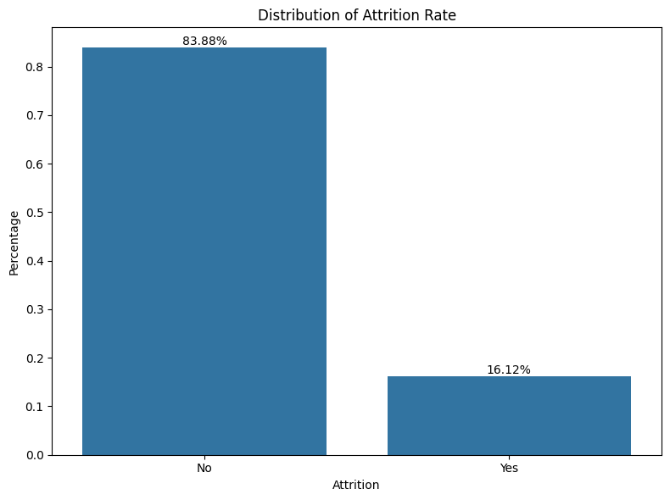
Distribution of Attrition Rate Description:
This bar plot shows the overall proportion of employees who have attrited ('Yes') versus those who have not ('No').
  Insight: It clearly illustrates the class imbalance in the dataset, with a much smaller percentage of employees having attrited (16.12%) compared to those who stayed (83.88%).

Slide 9
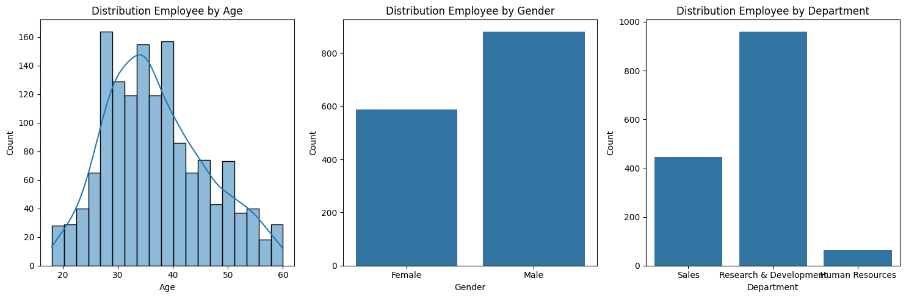
Employee Distribution Plots Description:
This figure contains three subplots:
  Distribution Employee by Age (Histogram): A histogram showing the frequency distribution of employees across different age groups.
  Distribution Employee by Gender (Count Plot): A bar plot showing the count of male and female employees.
  Distribution Employee by Department (Count Plot): A bar plot showing the count of employees in each department.
Insight: These plots provide a general overview of the demographic composition of the workforce, such as the age distribution (most employees are in their late 20s to early 40s), gender balance, and department sizes.

Slide 10
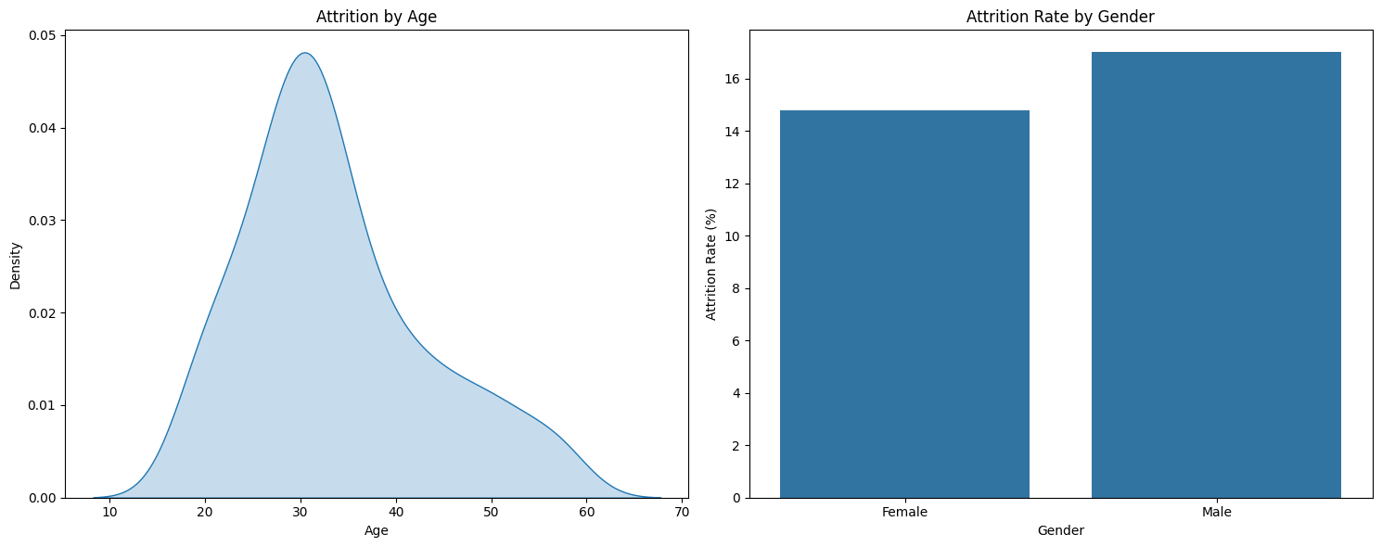
Attrition by Age and Gender Description: This figure contains two subplots:
    Attrition by Age (KDE Plot): A Kernel Density Estimate (KDE) plot showing the distribution of age specifically for employees who have attrited.
    Attrition Rate by Gender (Bar Plot): A bar plot showing the percentage of attrition for male and female employees.
  Insight: The KDE plot for age suggests that younger employees, particularly those in their late 20s and early 30s, have a higher density of attrition. The gender bar plot indicates that attrition rates are quite similar between male and female employees, suggesting gender is not a primary differentiator for attrition.

Slide 11
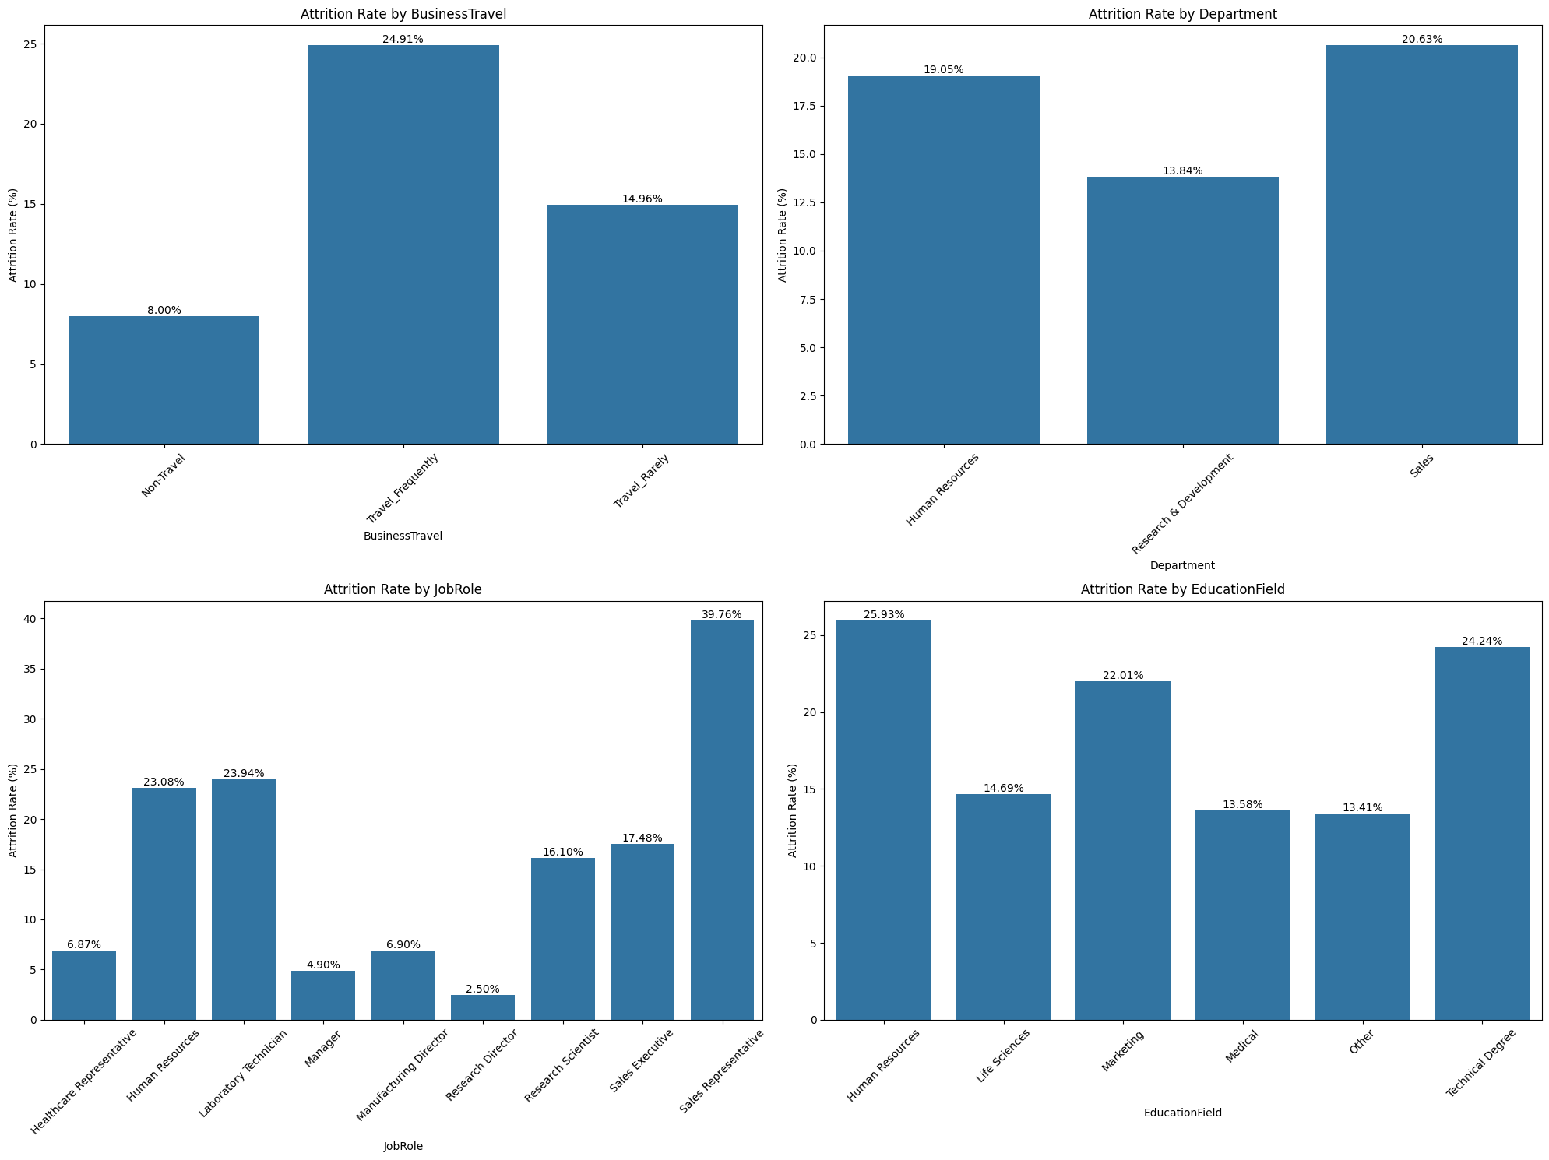

Slide 12
Attrition Rate by Categorical Features (Group 1) Description: This figure contains four bar plots, each showing the attrition rate (percentage) for different categories within:
    Business Travel
    Department
    Job Role
    Education Field
  Insight: These plots help identify specific categories within these features that have significantly higher attrition rates. For example, 'Travel Frequently' shows a much higher attrition rate than 'Travel Rarely' or 'Non-Travel'. 'Sales' and 'Human Resources' departments, and 'Sales Representative' and 'Laboratory Technician' job roles, also show elevated attrition.

Slide 13
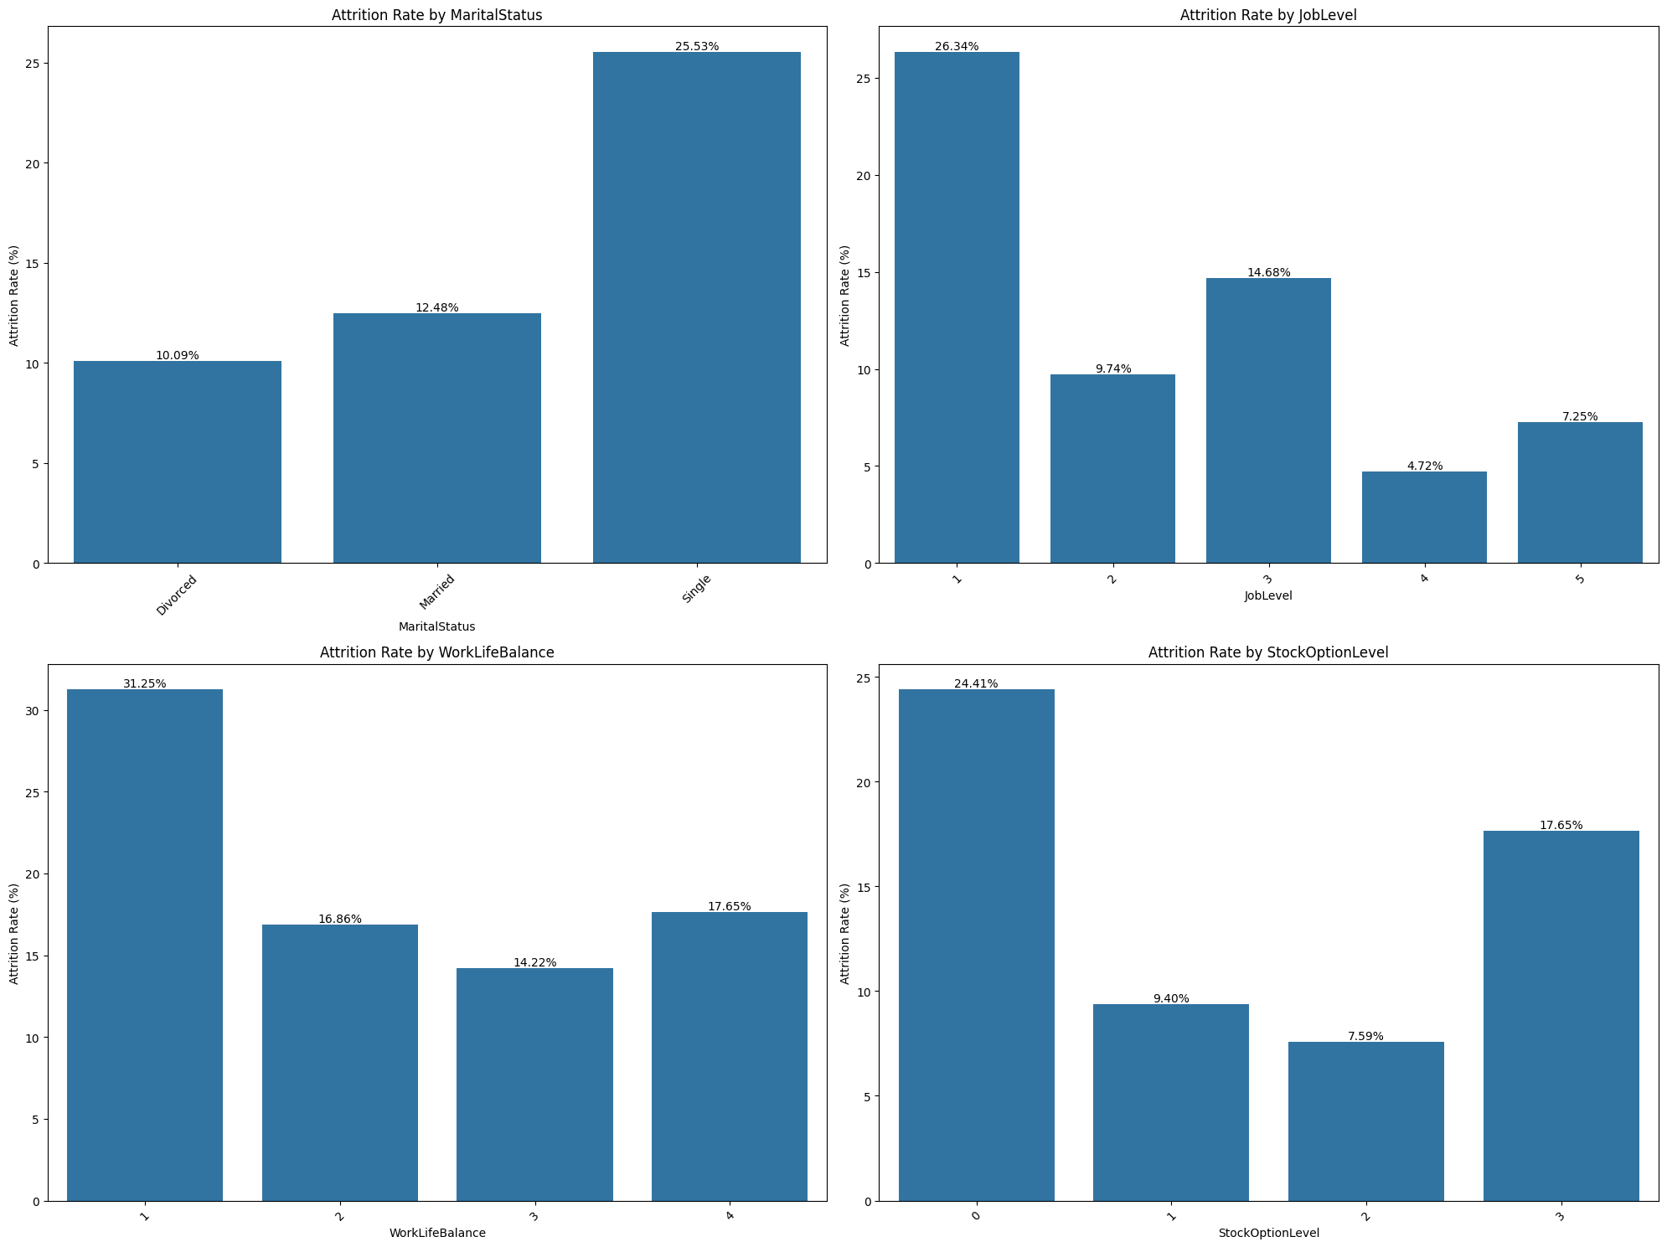

Slide 14
Attrition Rate by Categorical Features (Group 2) Description: This figure contains four bar plots, similar to the previous set, showing the attrition rate for different categories within:
    Marital Status
    Job Level
    Work Life Balance
    Stock Option Level
  Insight: These plots highlight that 'Single' employees have a higher attrition rate. Lower 'JobLevel' values (1 and 2) correspond to higher attrition. Employees with a 'WorkLifeBalance' of 1 (Bad) and 'Stock Option Level' of 0 also show higher attrition rates.

Slide 15
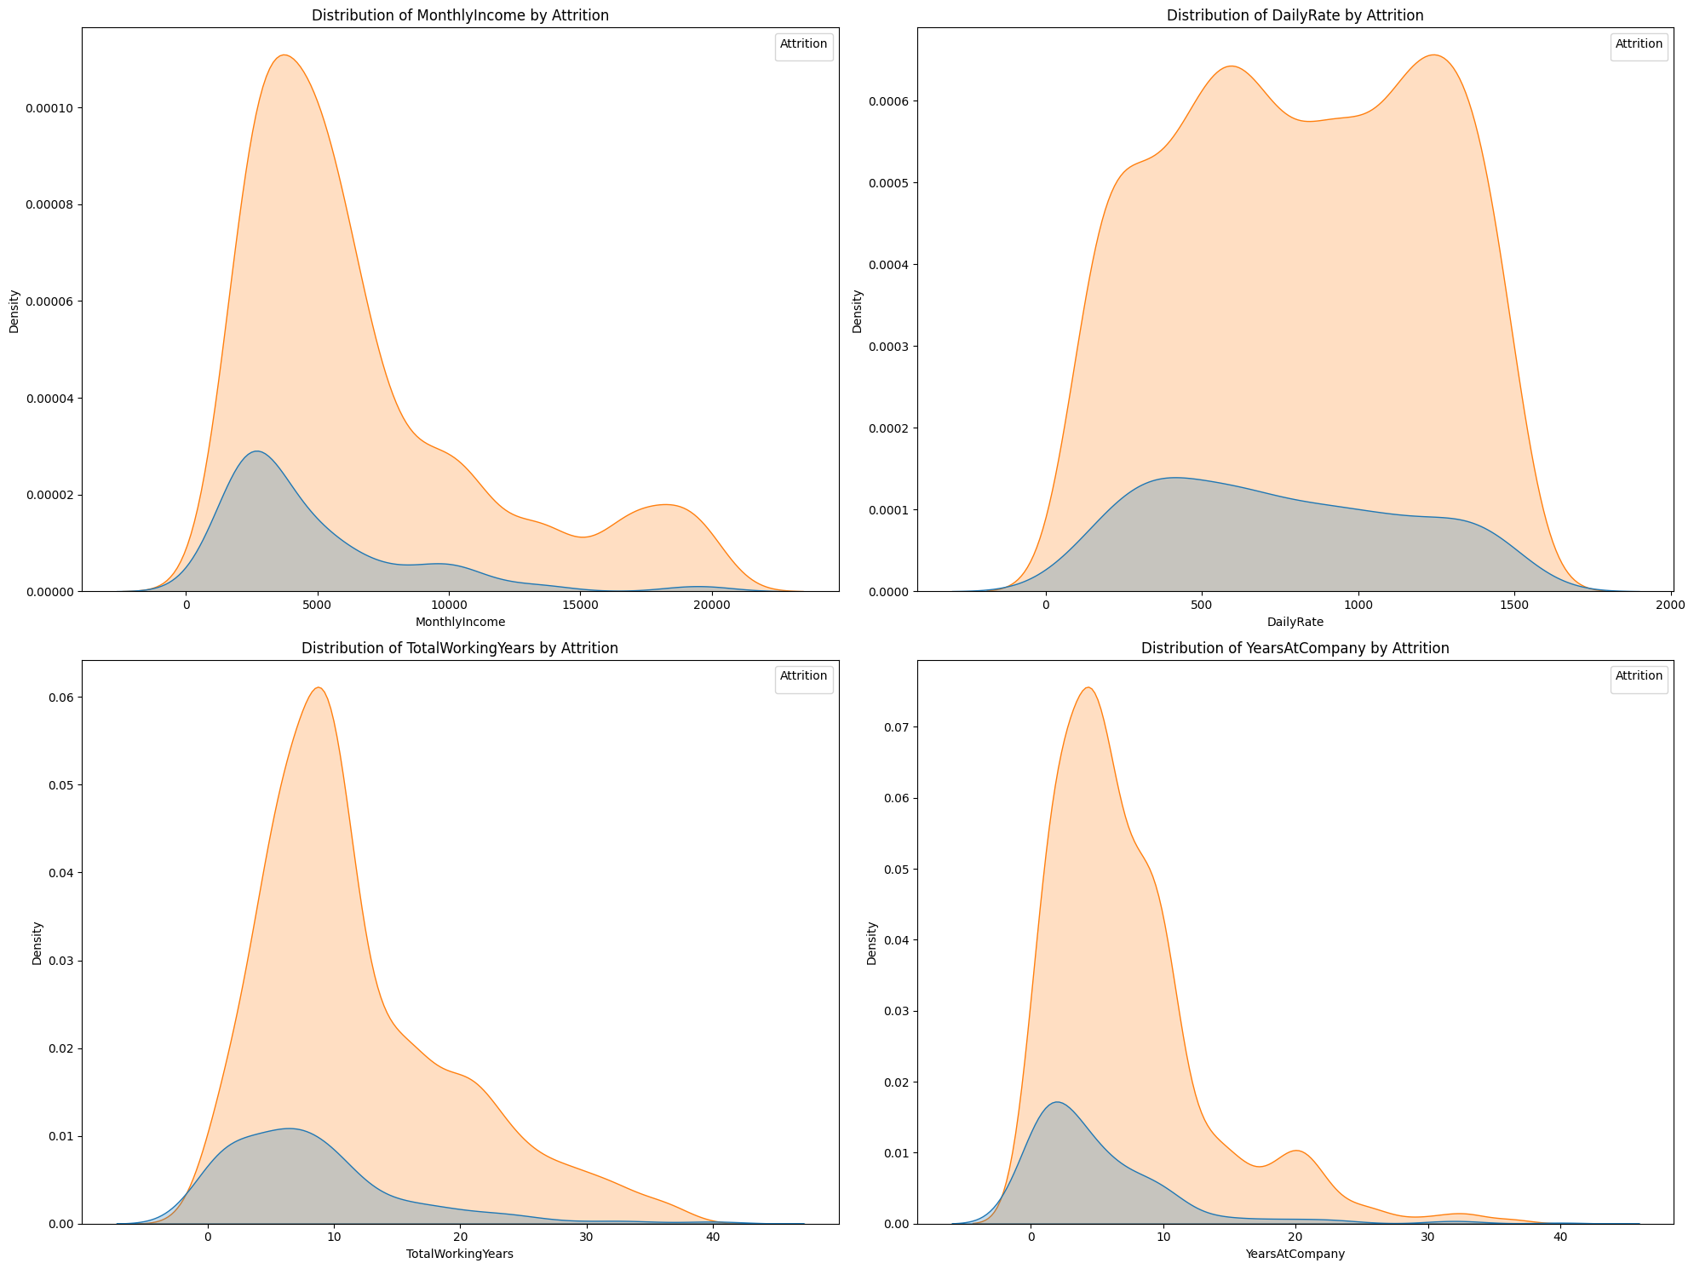

Slide 16
Distribution of Numerical Features by Attrition Description: This figure contains four KDE plots, showing the distribution of:
    Monthly Income
    Daily Rate
    Total Working Years
    Years At Company Each plot differentiates between employees who attrited ('Yes') and those who did not ('No').
  Insight: These plots help visualize how the distribution of these numerical features differs between the attrited and non-attrited groups. For instance, employees with lower 'MonthlyIncome', 'DailyRate', 'TotalWorkingYears', and 'YearsAtCompany' tend to have a higher density in the 'Yes' attrition category, suggesting these factors are associated with higher attrition risk.

Slide 17
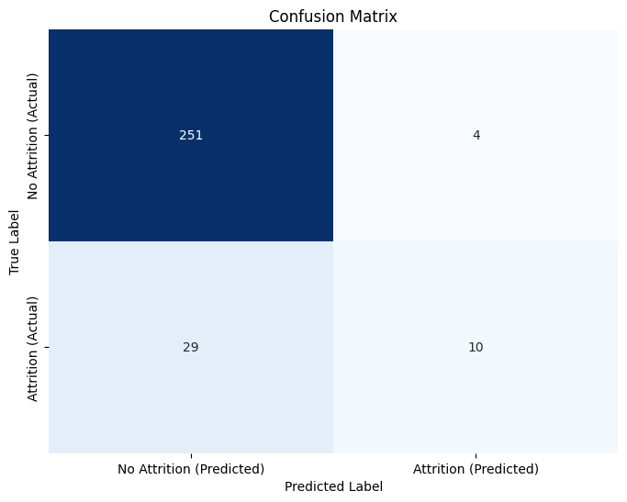
Logistic Regression Confusion Matrix Description: A heatmap showing the performance of the Logistic Regression model in classifying attrition. It displays True Positives (correctly predicted attrition), True Negatives (correctly predicted no attrition), False Positives (incorrectly predicted attrition), and False Negatives (incorrectly predicted no attrition).
  Insight: This matrix visually confirms the model's performance metrics, particularly highlighting the challenge with recall for the 'Attrition (Yes)' class, as indicated by a relatively high number of False Negatives (actual attrition, but predicted no attrition).

Slide 18
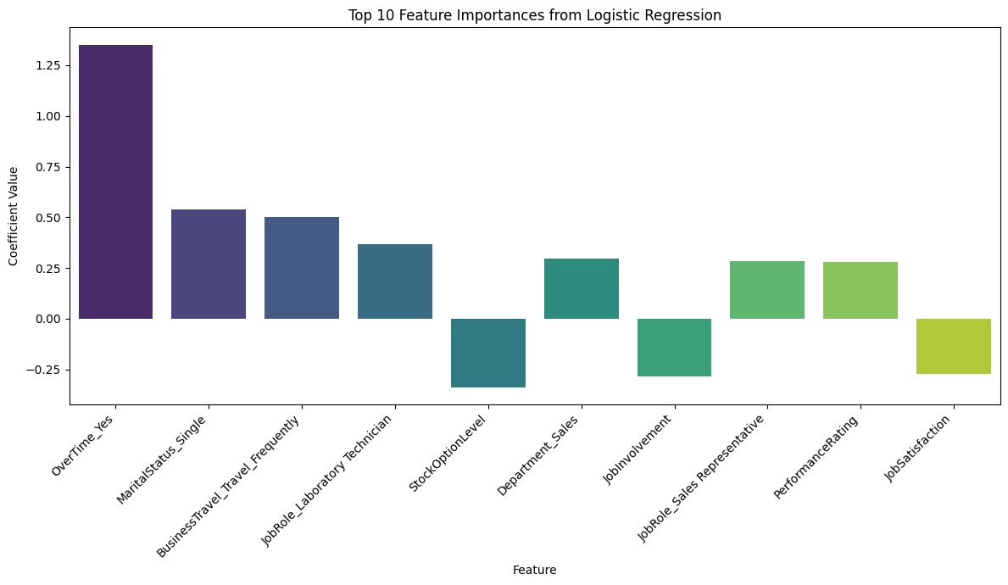
Top 10 Feature Importances from Logistic Regression (from cell 30911d79):
  Description: A bar plot displaying the top 10 features that had the largest absolute coefficient values in the trained Logistic Regression model. The coefficient values indicate the strength and direction of the relationship between the feature and the log-odds of attrition.
  Insight: This plot identifies the features that the Logistic Regression model considered most influential in predicting attrition, such as 'OverTime_Yes', 'JobRole_Sales Representative', and 'MaritalStatus_Single'.

Slide 19
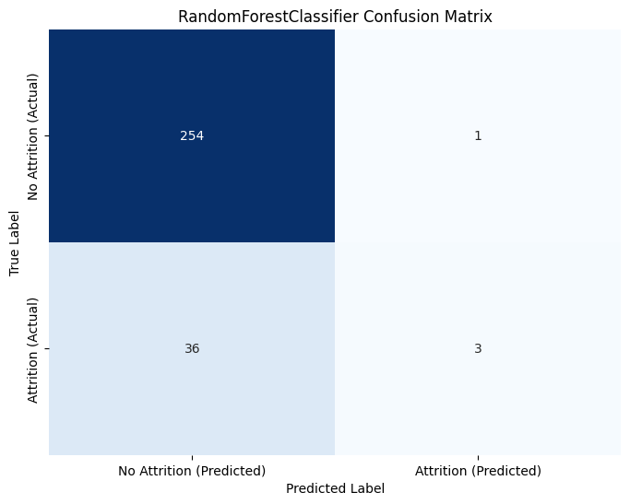
Random Forest Classifier Confusion Matrix Description: A heatmap similar to the Logistic Regression confusion matrix, but for the RandomForestClassifier model. It shows its performance in terms of True Positives, True Negatives, False Positives, and False Negatives.
  Insight: This matrix, again, reveals the model's strengths and weaknesses, specifically showing that while the Random Forest has high precision for the 'Attrition (Yes)' class, its recall is still quite low, meaning it misses many actual attrition cases.

Slide 20
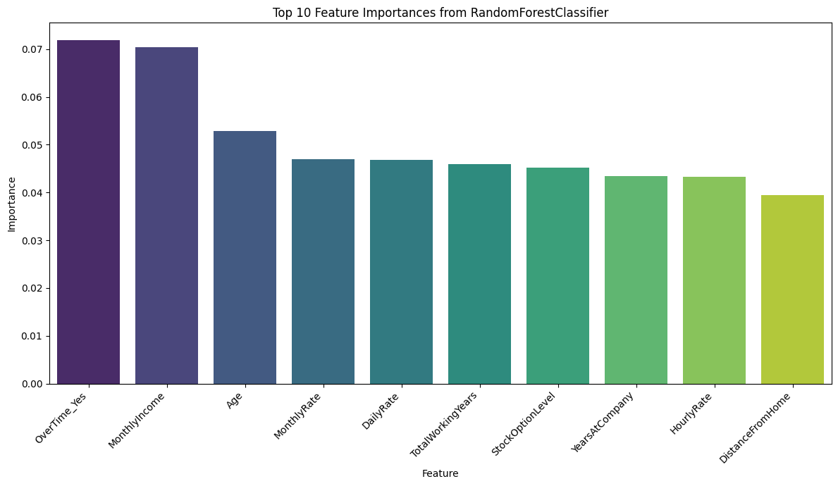
Top 10 Feature Importances from RandomForestClassifier Description:
A bar plot displaying the top 10 features that the RandomForestClassifier model deemed most important for predicting attrition, based on its internal feature importance scores (e.g., Gini importance).
  Insight: This plot provides a different perspective on feature importance compared to Logistic Regression. It highlights features like 'MonthlyIncome', 'Age', 'TotalWorkingYears', and 'DailyRate' as particularly influential for the Random Forest model.

Slide 21
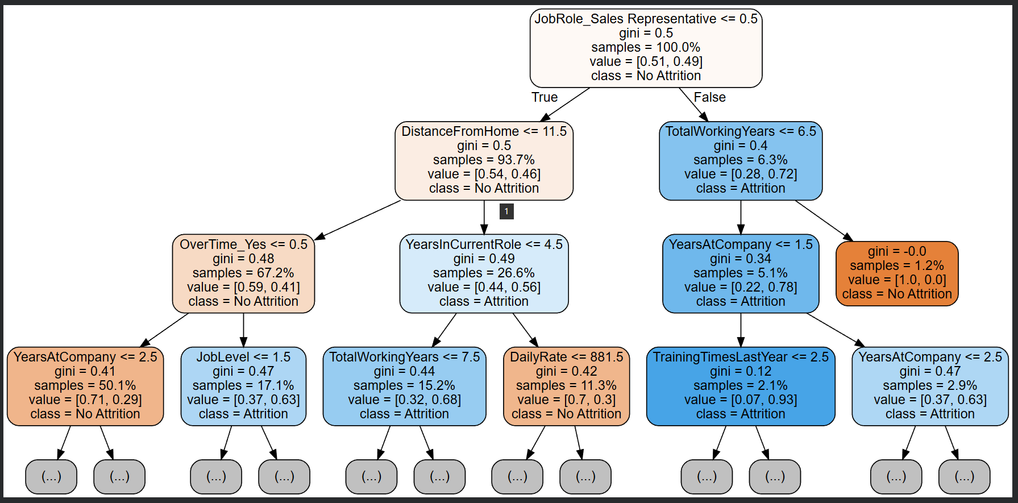
Decision Tree from Random Forest Description:
A visualization of a single decision tree extracted from the trained Random Forest model. The max_depth was limited to 3 for readability.
  Insight: This plot helps in understanding the decision-making logic of one of the individual trees within the Random Forest. It shows how the tree splits data based on feature values to classify employees as likely to attrite or not, providing a glimpse into the model's internal workings.

